Slide 1

Tourism as a source of vulnerabilities ?
The role of Islands ‘Heritage
Vincent Geronimi, Christine Le Gargasson,
Natalia Zugravu, Jessy Tsang King Sang
Colloque « Spécialisation touristique et vulnérabilité : Réalités et enjeux pour le développement soutenable des petits territoires insulaires », CEMOI, 4-6 décembre 2014, Université de la Réunion.

Slide 2
Introduction
Under which conditions a tourism specialization can be sustainable for Small Island Economies ?
Ambiguous results on the connections between growth and tourism specialisation:
  Engine of growth (Lanza & Pigliaru, 2000 ; Pablo-Romero & Molina, 2013), and more specifically for small islands economic development (Hampton & Jeyacheya, 2013 ; Seetanah, 2010)…
  …Though with a decreasing marginal impact on economic development (Holzner, 2011 ; Adamou & Clerides, 2010).
Our own results exhibit a non-linear connection between tourism specialisation and vulnerability (Economic Vulnerability Index, EVI):
  Tourism specialisation increases economic vulnerability using a large sample of countries.
  We also find that for limited and strong tourism specialisation, tourism specialisation increases economic vulnerability, though intermediate tourism specialisation does not impact vulnerability, for SIDS and non-SIDS as well.

Slide 3
Tourism contribution to Vulnerability
Results from a panel regression with random effects
List of variables
EVI | Retrospectif EVI according to the 2012 definition
GDPcap | GDP per capita (constant 2005 US$) [NY.GDP.PCAP.KD]
K | Gross fixed capital formation (constant 2000 US$)
Labor | Labor force, total
Voice&Account | Voice and Accountability: Estimate
Open | Trade (% of GDP) [NE.TRD.GNFS.ZS]
FDI | Foreign direct investment, net inflows (BoP, current US$) [BX.KLT.DINV.CD.WD]
Education | Labor force with tertiary education (% of total)
NatResRent | total natural resources rents of gdp
TourGDP | Tourism contribution to GDP_% share
latitude | Latitude in degrees
SIDS | =1 if SIDS, 0 - otherwise

Slide 4
Introduction
Thus thresholds affect the relationship between tourism, growth and vulnerability
Considering vulnerability as a risk of non-sustainability, we propose here an analysis of these thresholds using a sustainability and total wealth approach (Hamilton 2006, Couharde et al.2010).
Two proposals:
  Tourism impacts on growth are shaped by the kind of tourist services supplied.
  For Small islands with high costs of production (mainly due to remoteness and limited size of markets), differentiated tourist services, based on heritage, are more likely to support weak and strong sustainability.

Slide 5
Outline
Assets, weak and strong sustainability
The stakes of tourism for small islands sustainability
Tourist services: price competition vs heritage based differenciation
Conditions for the sustainability of tourism specialization.

Slide 6
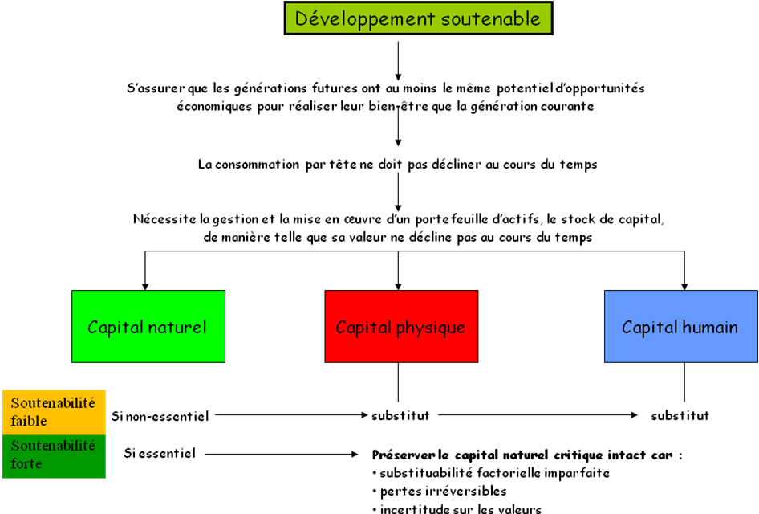
Sustainability definition: an asset based approach

Slide 7
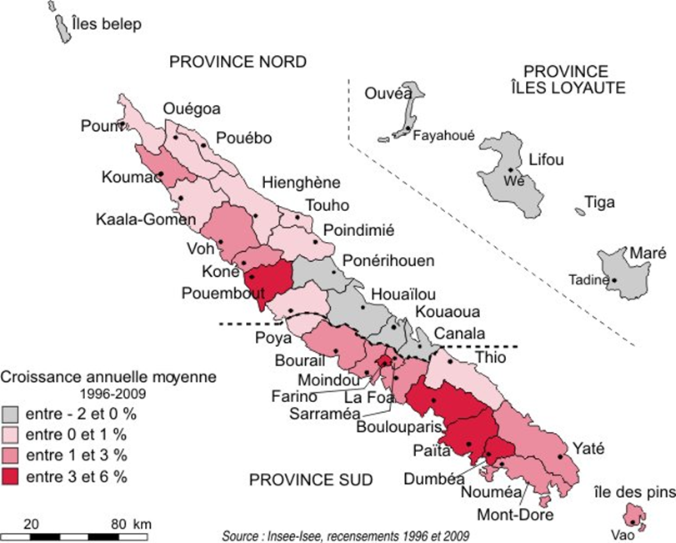
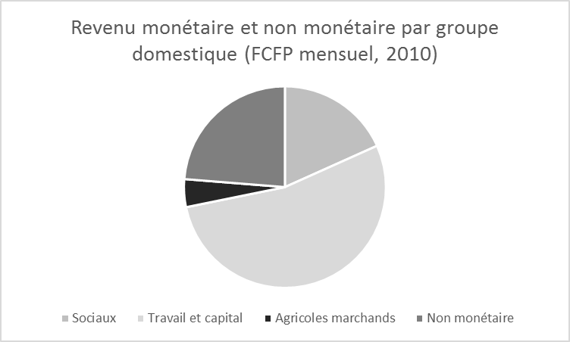
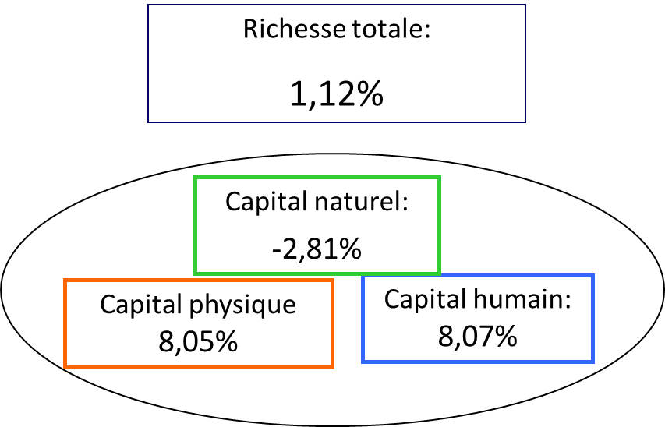
Weak and strong sustainability: New-Caledonia
Weak Sustainability:
Genuine savings > 0
Investment in economic and human capital more than compensates the depreciation of natural capital
Strong Sustainability:
Limited rural migration
(Pestana, 2012)
Preserved social and human capital (IAC, 2013)
The question of public transfers (géo-strategic capital ) ?

Slide 8
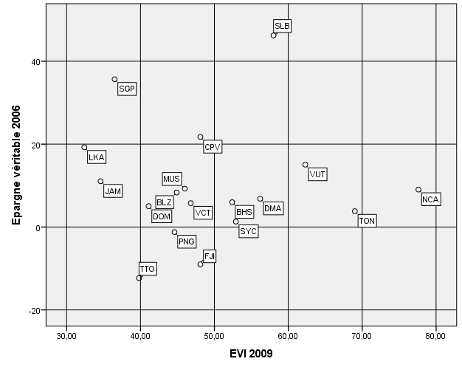
Weak sustainability vs vulnerability: the heterogeneity of SIDS
La diversité des petites économies insulaires (PEI), et des Small Islands Development States (SIDS) au regard des critères de soutenabilité et de vulnérabilité

Slide 9
Rents, assets and total wealth
Following Hamilton (2006), the natural capital is valuated through rents (the difference between price and costs of production).
Intangible capital is the most important component of total wealth. It encompasses all components that are not directly computed: human capital, social capital, cultural capital,…
Each rents can be associated to a specific capital.

Slide 10
PEI: Assets, rents, risks and sustainability
Assets | Assets / Heritage | Rents | Risks | Strong sustainability
Natural capital | Natural capital | Exports of primary commodities | Fluctuation of international prices | Simultaneaous degradation of different capitals: loss of human capital and social capital (e.g. rural emigration)
Intangible capital | Human and social capital | Migrations | Closure of boundaries and "brain drain" | Loss of social and human capital with decreasing remittances
 | Geo-strategic capital | Military, nuclear or strategic and administrative | Volte-face and decreasing transfers | Decreasing geo-strategic stakes

Slide 11
Heritage based tourism and rents
Tourist services non differentiated, competition through price (sea/beach/sun):
  No rents and high costs (remotness,…)
Differentiated tourist services (heritage based, on specific assets), sources of rents
Capital/ Heritage | Rents | Non sustainability risks
Specific intangible capital; Human, social and cultural | Differentiation of tourist services: Prices higher than average costs of production | Loss of differentiation: folklorisation, depreciation of social capital and traditionnal sectors (ex. Bali, île de Pâques)
Outstanding natural capital |  | Over-crowding, environmental degradation

Slide 12
Typology of SIDS’ tourist services: competition through prices or heritage mobilization
 |  | Tourism specialization Average 1988-2013
 |  | Weak/ Limited (<20%) | Medium/ Strong (>20%)
« Price » evolution (Tourists expenditures per capita (1988-2013)) | <0 | Limited tourism specialization Guinée Bissau, Guyane, Haïti, Papouasie Nouvelle-Guinée, Bahreïn, Seychelles, Singapour, Trinidad et Tobago | Non differentiated Tourist Services Maurice, République dominicaine, Fidji, Jamaïque, Sao Tome et Principe, Belize, Cap-Vert
 | >0 |  | Differentiated tourist services Tonga, Saint Kitts et Nevis, Antigua et Barbuda, Grenades, Bahamas, Vanuatu, Sainte Lucie, Dominique, Samoa, Saint Vincent, Maldives

Slide 13
Perspectives
Tourism and connections between different kind of capital. Some preliminary results:
  Concerning the impact of tourism on the GDP per capita
    Substituability between tourism and economic / human capital for low level of the latters, complementarity for high level of human and economic capital
    Complementarity between tourism and natural capital
    For SIDS, complementarity between tourism and natural capital
Integration of heritage (e.g. Arezki et al., 2009, using World Heritage List) in the analysis of the connection between tourism and economic development. Measuring cultural capital.

Slide 14
Thank you !

